Slide 1
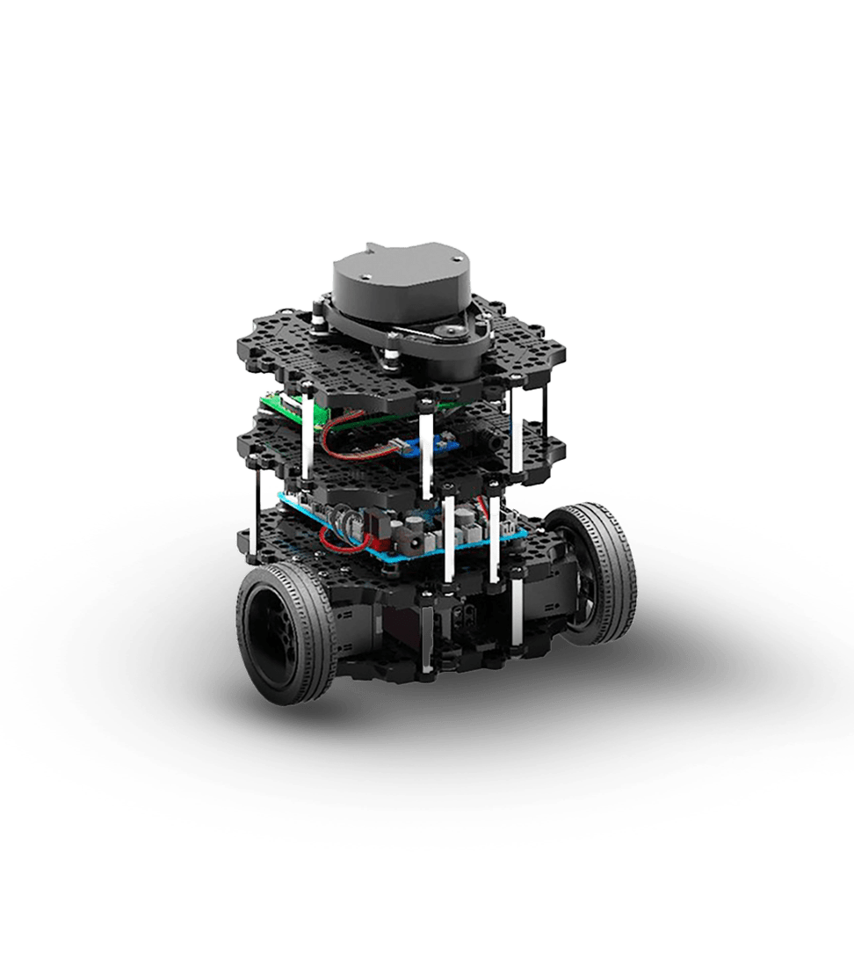
Refined Project
Alessio Petrone
Silas Leuenberger
Notes:
https://robotican.net/turtlebot-open-source-personal-research-robot-2/

Slide 2
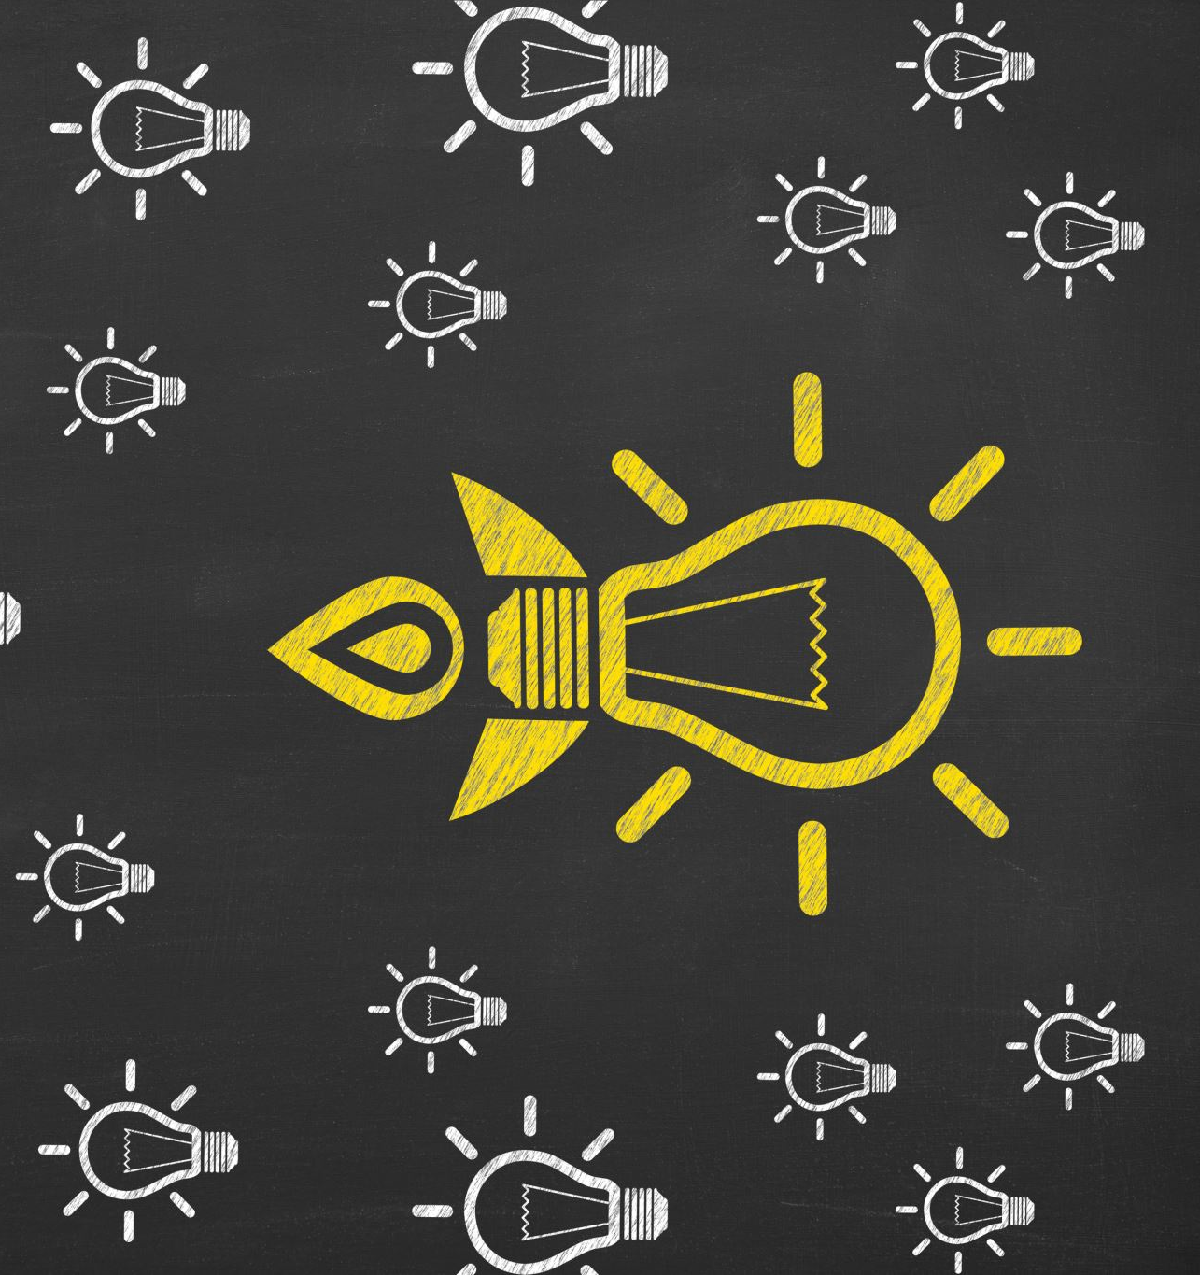
Idea Recap

Slide 3
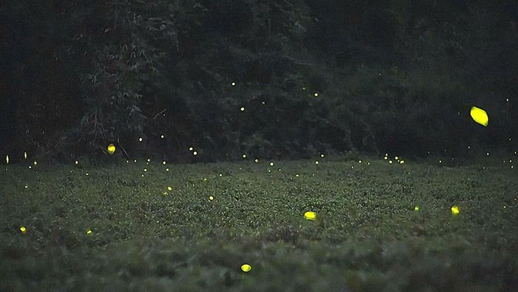
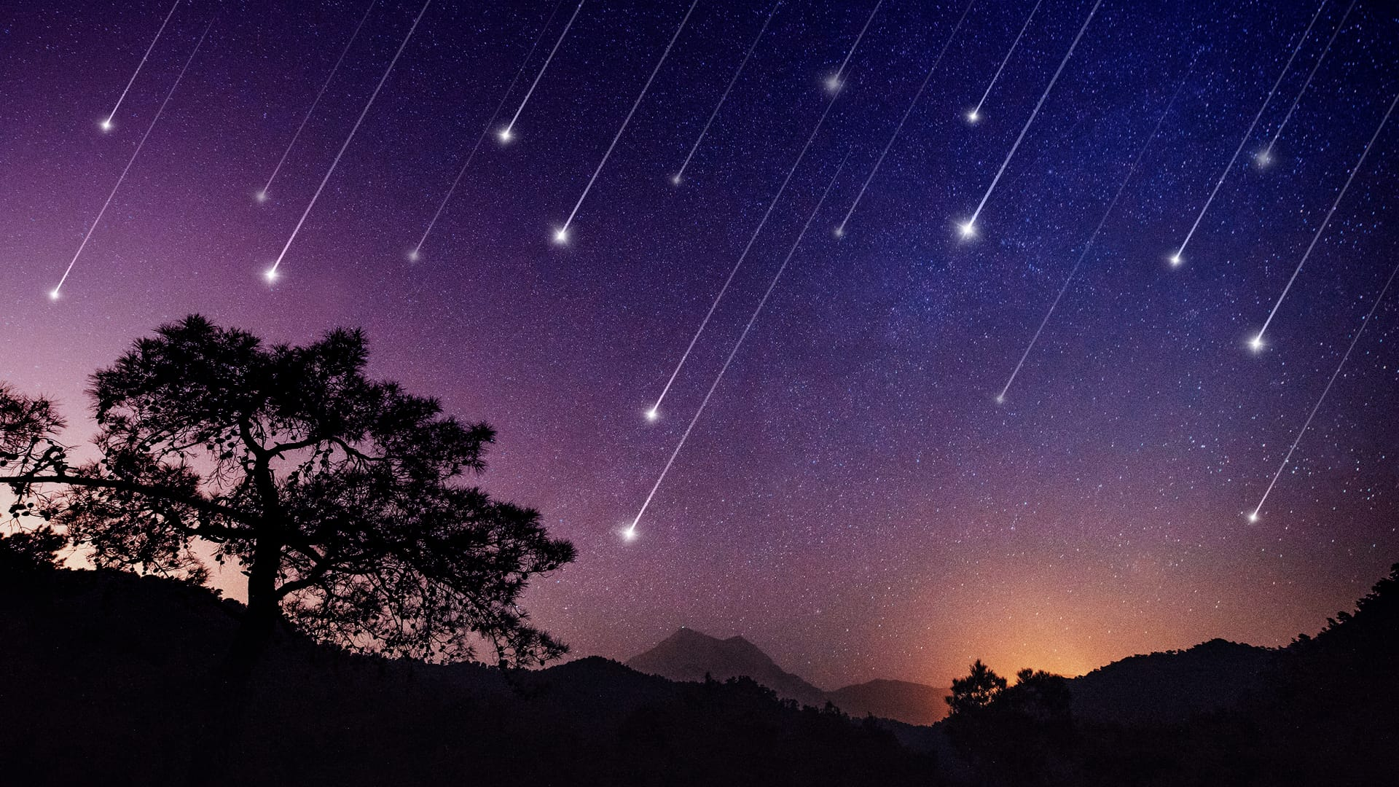
Hope
Hope through lights
Lights flying through the air
Giving a little show
Fireflies
Hope: Small sparks of light in the dark
Shotting Stars
Hope: Brief bursts of light

Slide 4
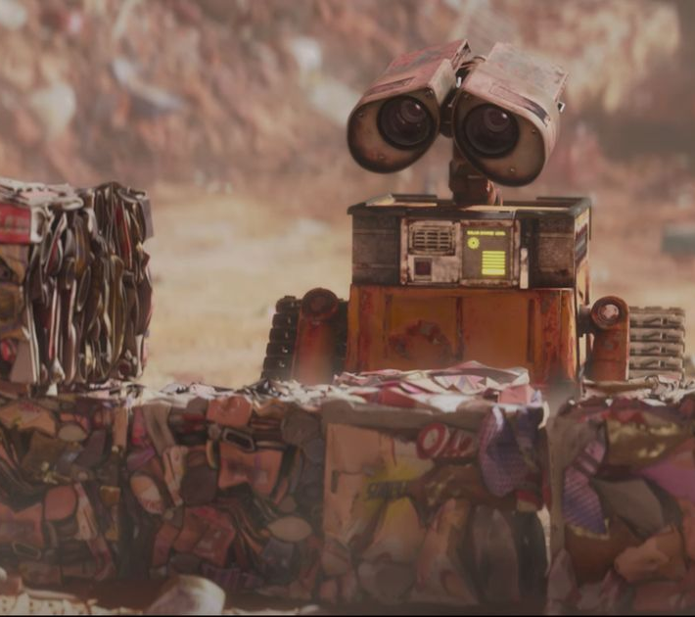
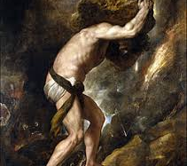
Dramaturgy
Turtlebot being captured in an endless cycle
Cycle does bring good
Wall-E
Dramaturgy: Tiny robot, tireless work in darkness.
Sisyphos
Dramaturgy: Endless cycle, persistence despite pointlessness

Slide 5
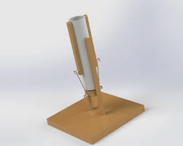
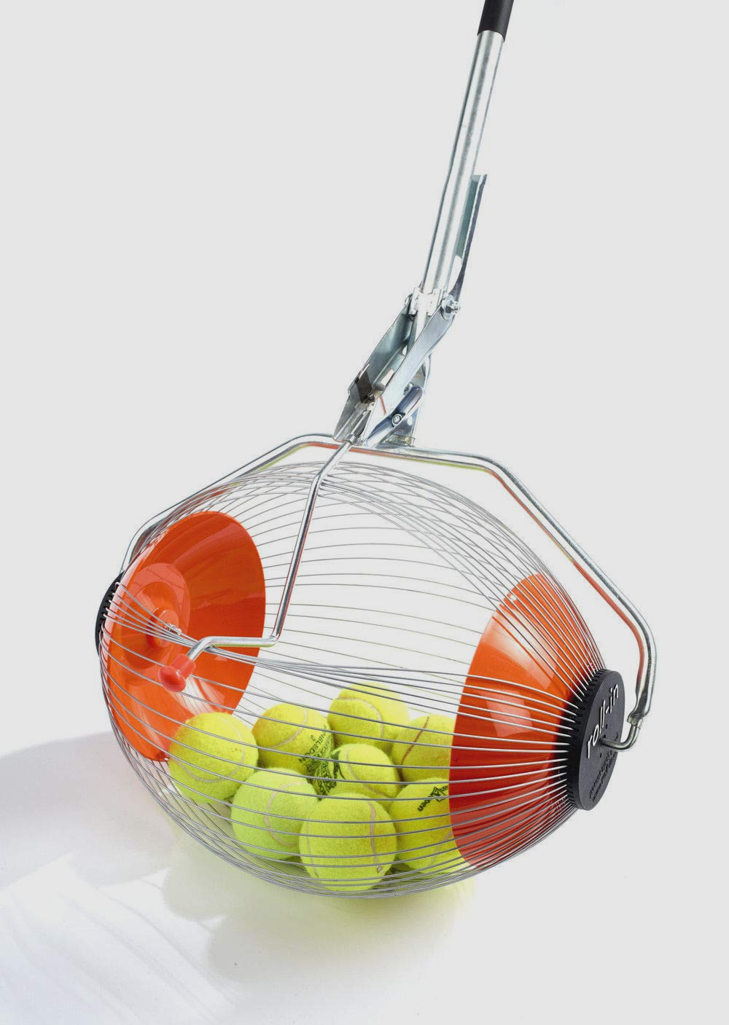

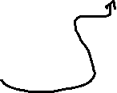
Have a Robot that ...
Propulses light into the air
Automatically moves to a light
Collects a light
Notes:
Propulsion: https://kolaszek.medium.com/moving-on-to-the-ping-pong-launcher-20afc0eca722
Collect: https://www.amazon.de/-/en/Kollectaball-K-MAX-Collector-coaching-accessories/dp/B07CGCHWRP
Turtlebot3: https://robotican.net/turtlebot-open-source-personal-research-robot-2/

Slide 6
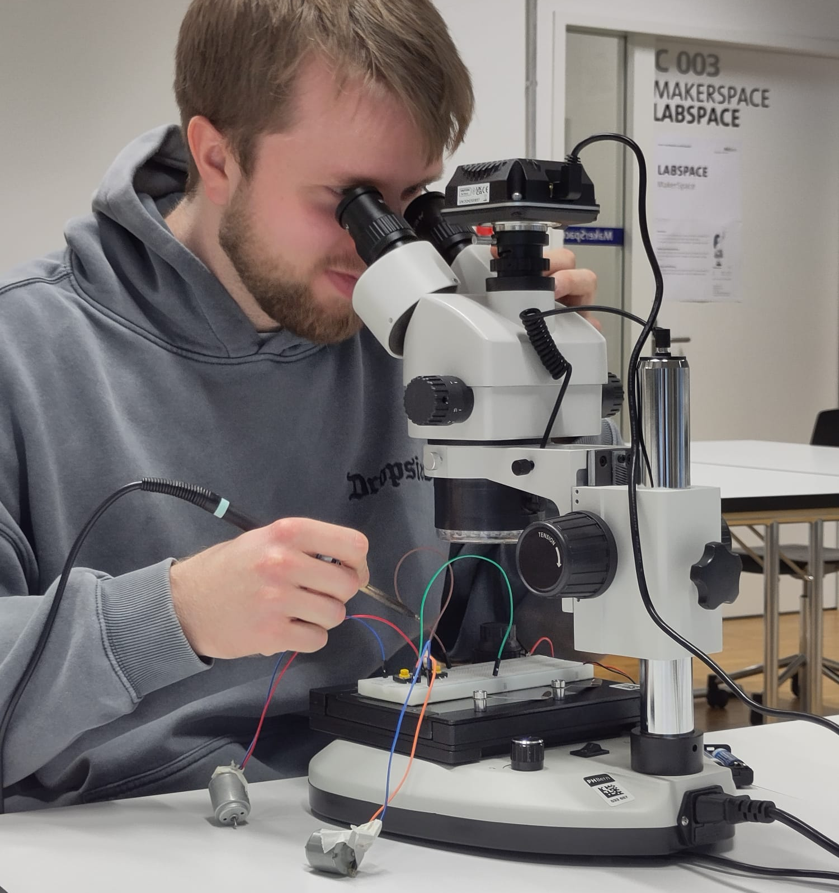
Current Progress

Slide 7
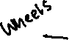

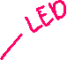



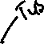




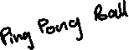
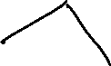
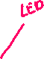
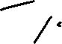

Original Plan
"..
Create LED-balls (LED inside Ping Pong Ball)
Create throwing mechanism
Add collecting machine
Move autonomously towards LED-Balls

Slide 8

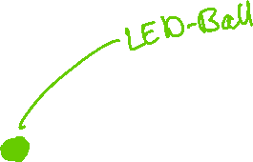
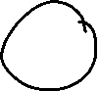

Adjusted Plan
"..
Create LED-balls (LED inside designed 3D-printed Ball)
Create combined collecting and throwing mechanism
Move autonomously towards LED-Balls

Slide 9
Adjusted Plan
"..
Create LED-balls (LED inside designed 3D-printed Ball)
Create combined collecting and throwing mechanism
Move autonomously towards LED-Balls

Slide 10
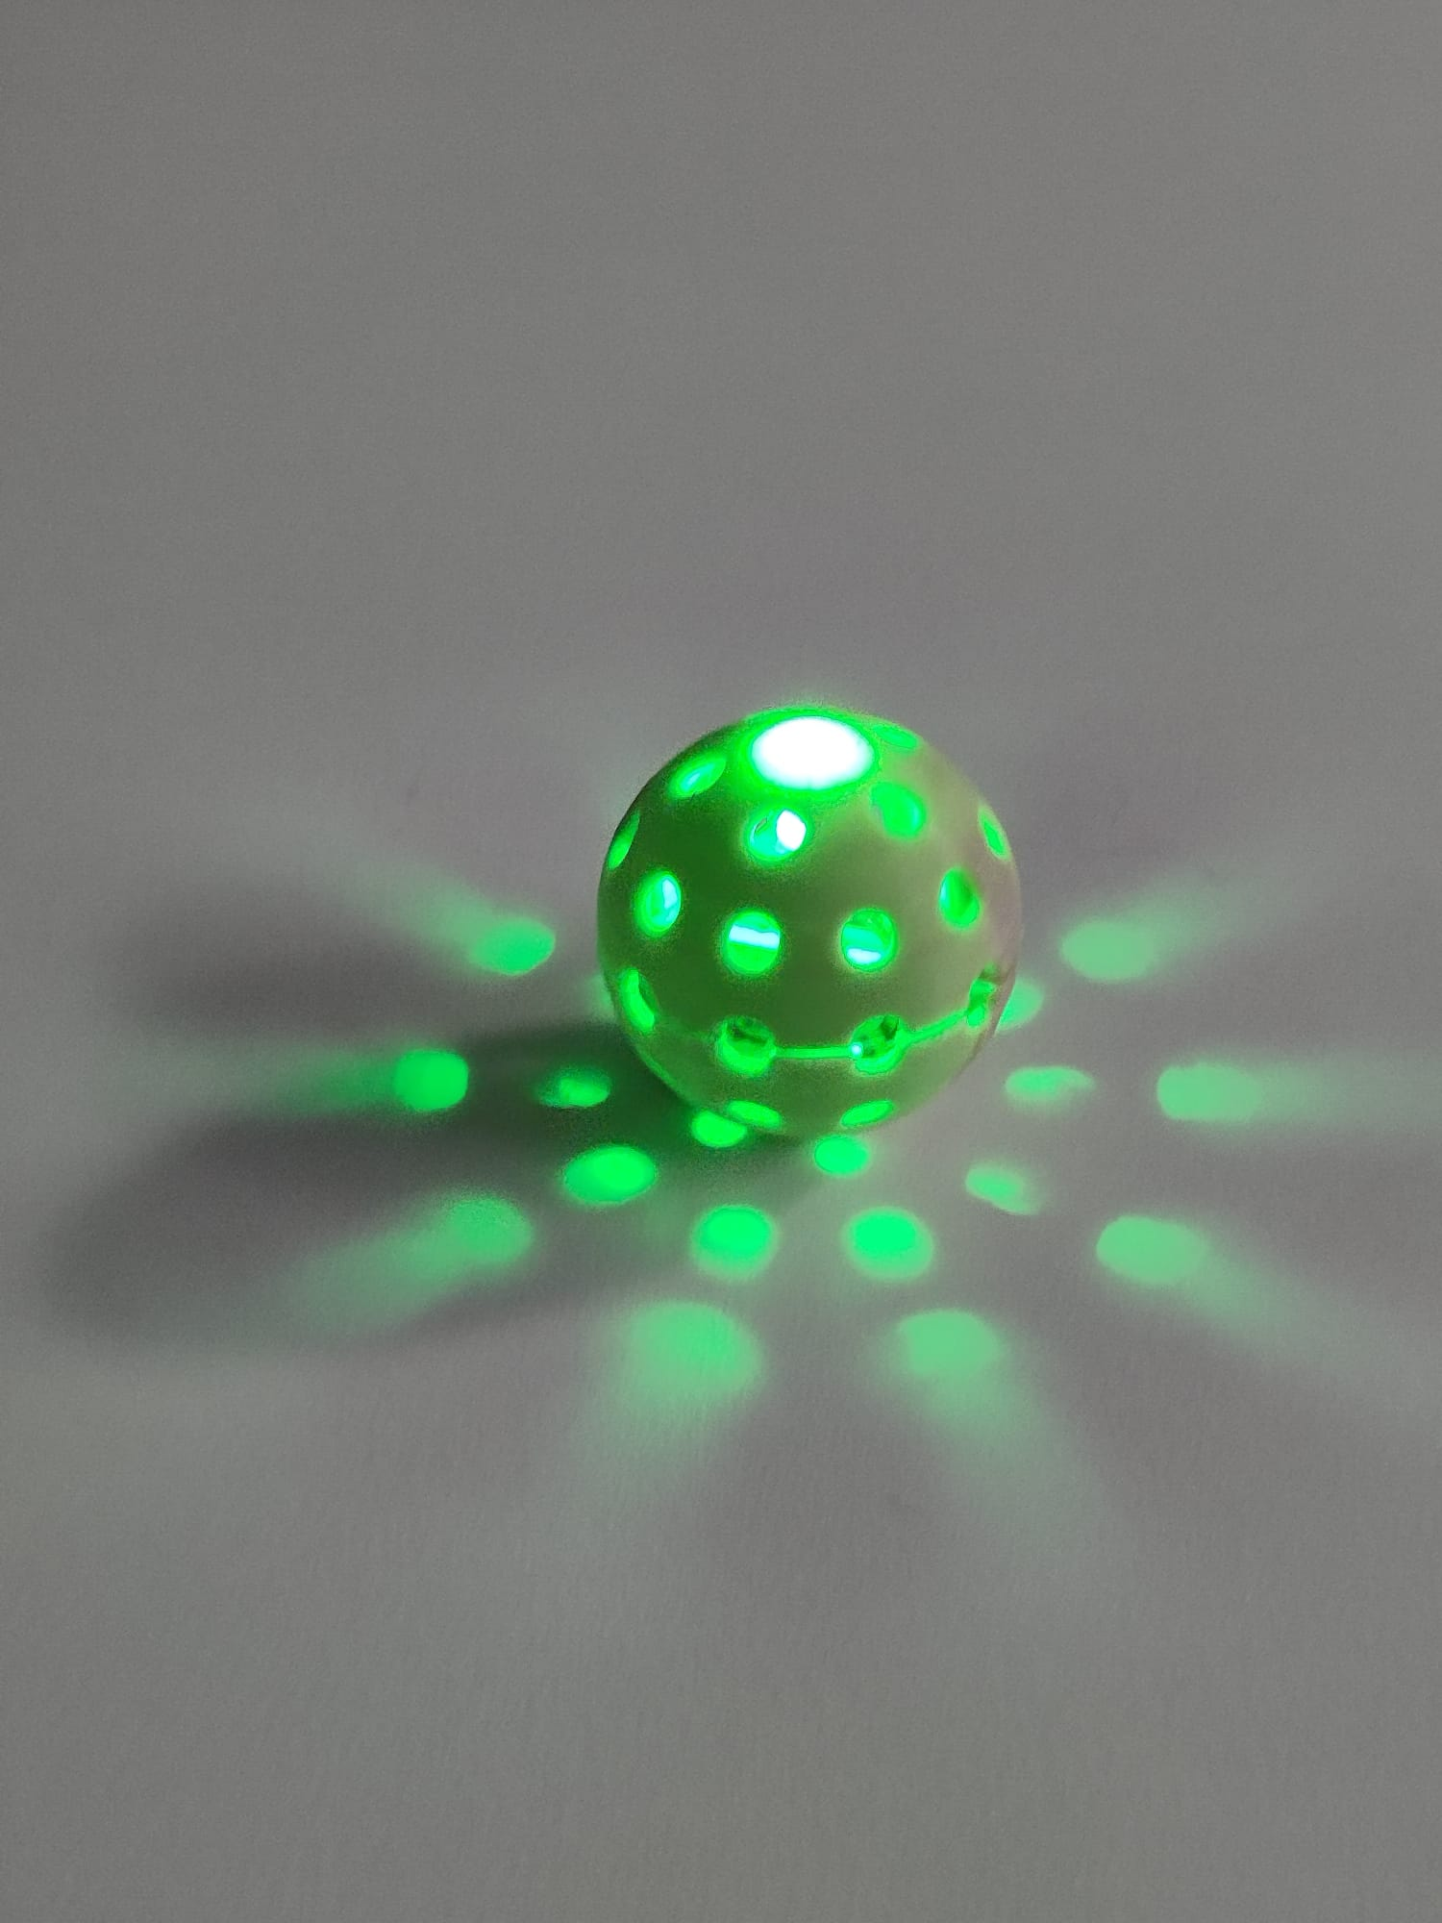
LED-Ball

Slide 11
Adjusted Plan
"..
Create LED-balls (LED inside designed 3D-printed Ball)
Create combined collecting and throwing mechanism
Move autonomously towards LED-Balls

Slide 12
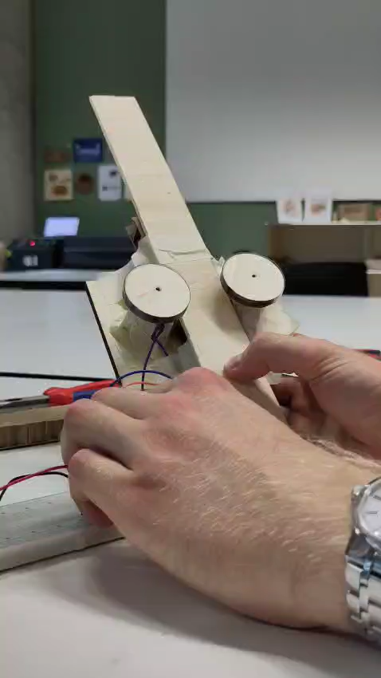
Throwing Prototype

Slide 13
Adjusted Plan
"..
Create LED-balls (LED inside designed 3D-printed Ball)
Create combined collecting and throwing mechanism
Move autonomously towards LED-Balls

Slide 14
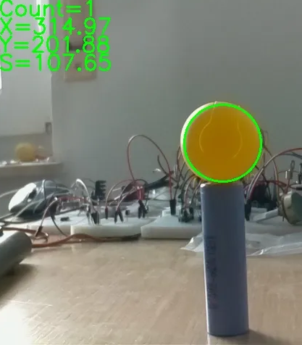
USB-Camera
Doing blob detection

Slide 15
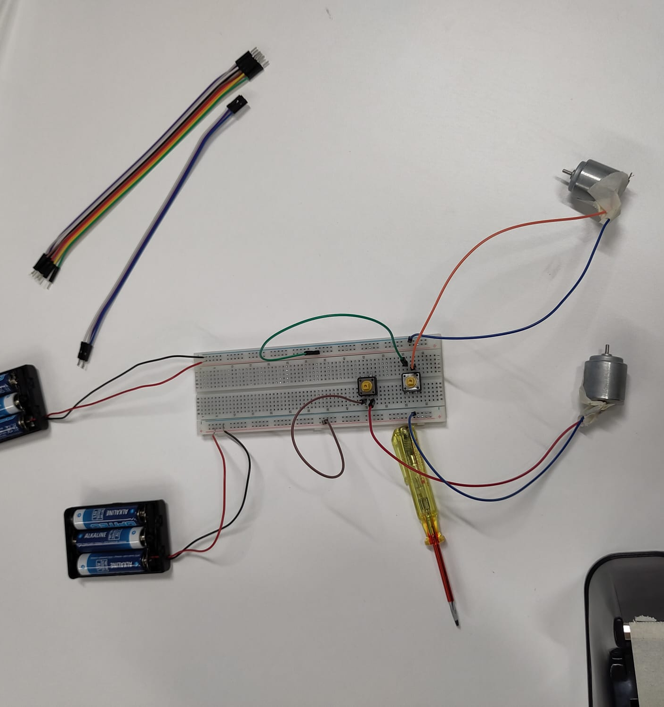
Global Architecture

Slide 16
Schema

Slide 17
How it could look like if we were a team of 10+
Have a cute looking robot
To create empathy for its suffering
More iterations for better prototyping
Direct slot for battery change in LED balls
More professional design for the propulsion slide
Testing more different options for the propulsion-mechanism
Nearly silent LED propulsion
Advanced automatic LED detection and then, collection

Slide 18
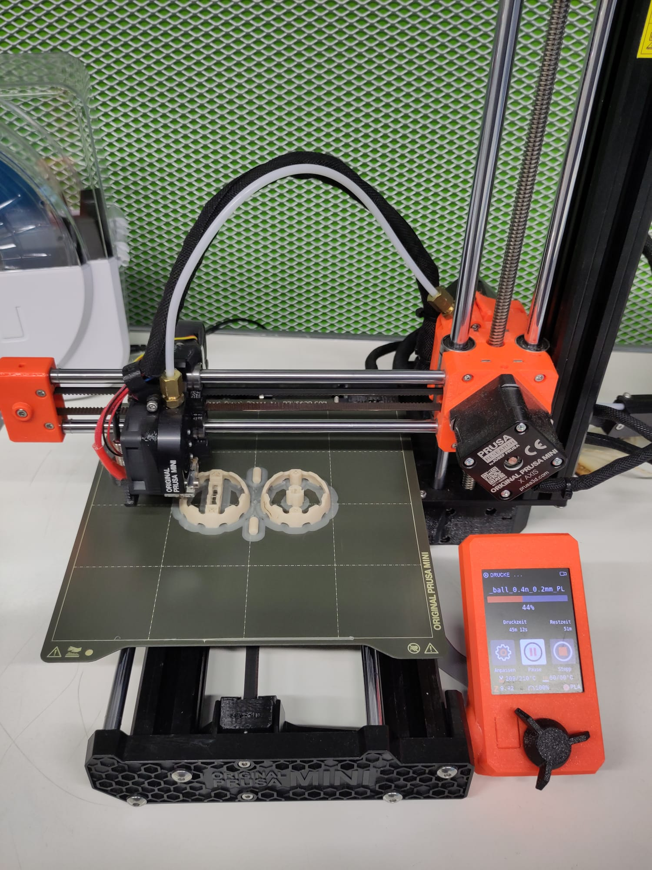
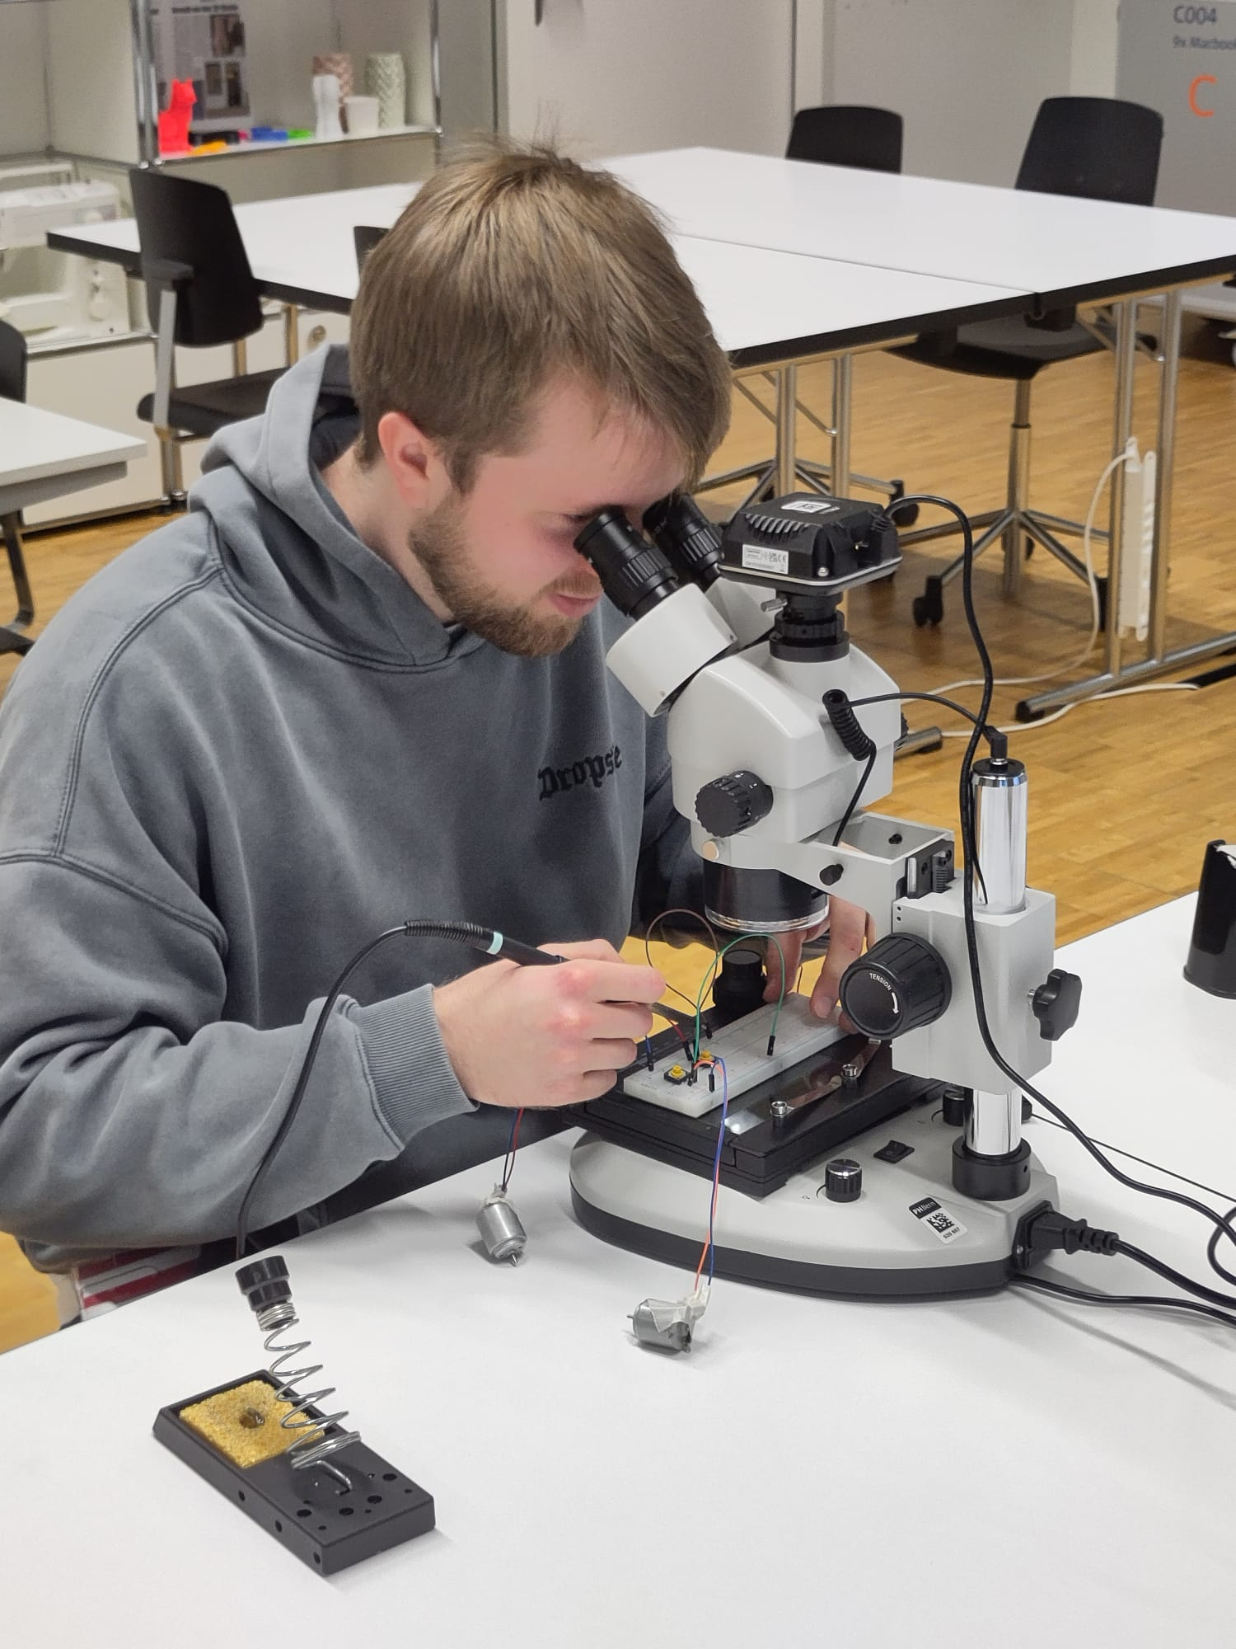
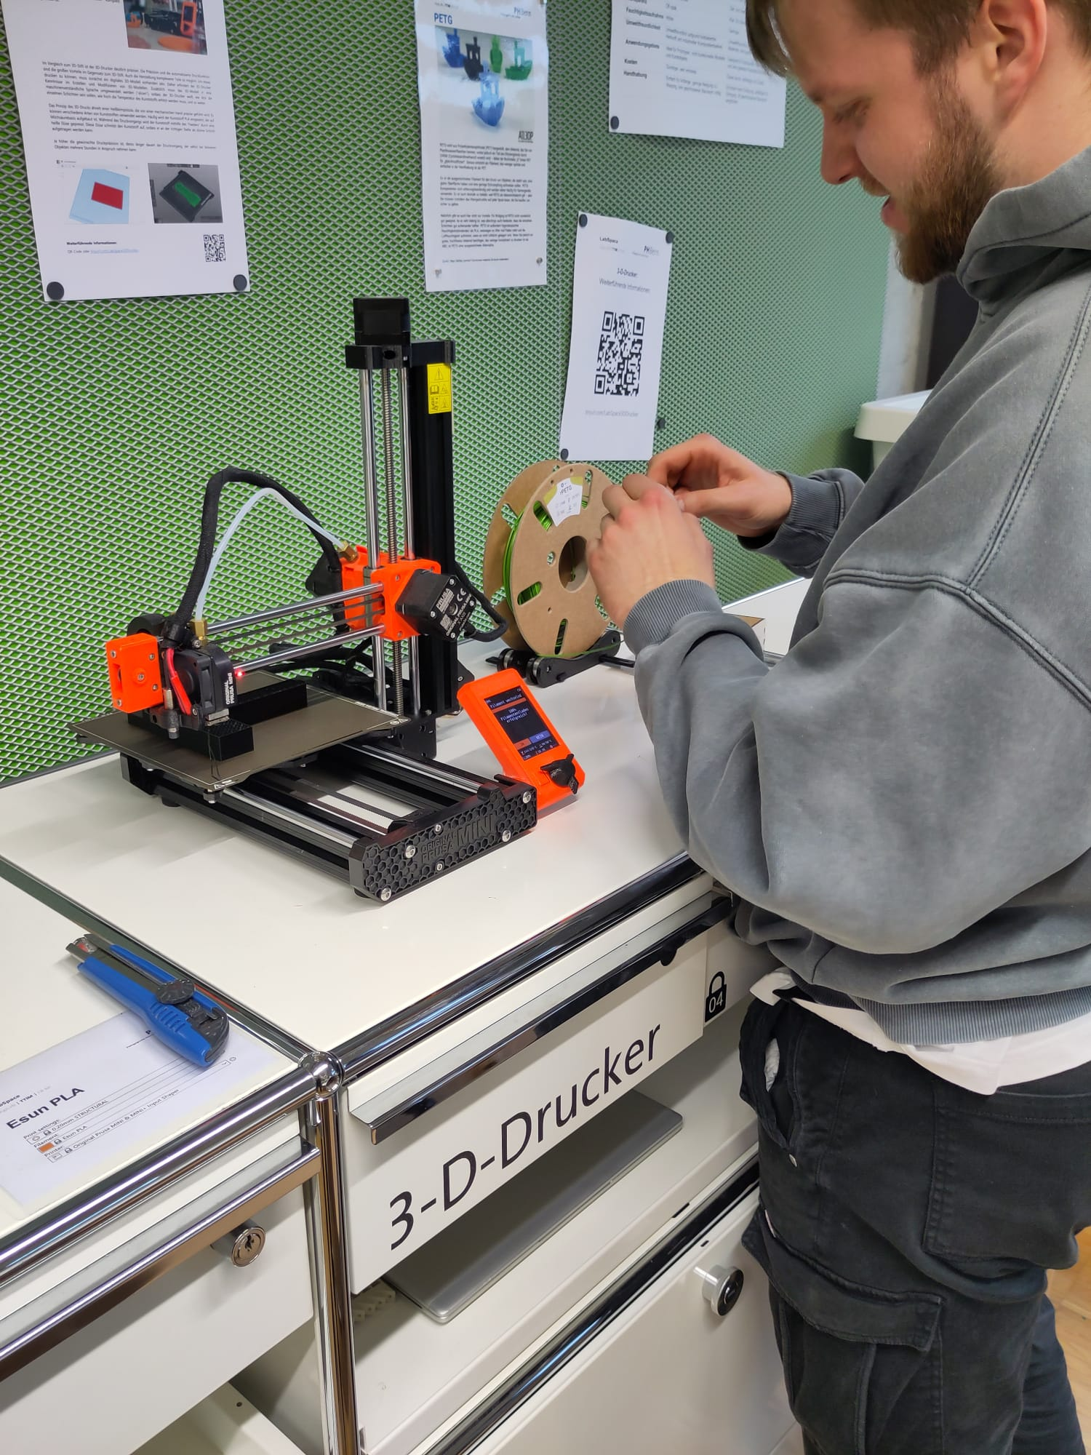
Any questions?

